Slide 1
Ratios and Scales

Slide 2
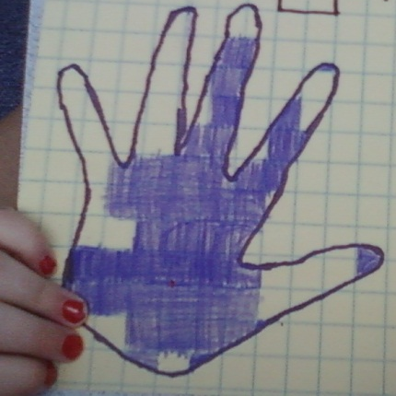
24
7
30
Topic: Ratios and Scales
Date:
EQ – How can a ratio help me read a map?
Discuss how large each square on the grid paper is
You will need to trace your hand onto the paper, and then colour in each square
Add a scale to your drawing
1 square : 1 cm
Count up how many squares are covered, count part squares as a half
Notes:
Distribute the cm grid paper to the students
Have the students do some simple area calculations e.g. a rectangle 3 squares x 2 squares is ? cm^2
Extension: have students assign decimals to the partially covered squares

Slide 3
24
7
30
Topic: Ratios and Scales
Date:
EQ – How can a ratio help me read a map?
You will need to copy your drawing onto the smaller grid paper. Take you time to get it right. Do it box by box to not get lost
Check how many boxes are coloured in, is it the same?
Add a scale to your drawing
1 cm drawing : 2 cm hand
Notes:
Distribute the 5mm grid paper to the students
Model drawing out the hand on the board box by box
Extension: Have the students work out how many 1cm boxes are coloured in, what is the ratio between the two (should be approx. 1:4)

Slide 4
24
7
30
Topic: Ratios and Scales
Date:
EQ – How can a ratio help me read a map?
Swap small grid drawings with a shoulder buddy
Measure the distance from the end of the little finger to the end of the thumb
Measure the distance from the end of the little finger to the end of the thumb on the larger grid drawing
Why should these be exactly double?
Notes:
Should be a 1:2 ratio

